Slide 1
Intel College Excellence Program
Analytics, AI & HPC
Creating Actionable Intelligence from Data

Slide 2
Program Description
The program is sectioned into three parts:
Part 1:
Five-day long intensive, hands-on workshop on Fundamentals of Linux, Data Analytics and Machine Learning Algorithms
Part 2:
Five-day long intensive, hands-on workshop on High Performance Computing and Deep Learning Algorithms
Part 3:
Project implementation on chosen problem statement by the students.

Slide 3
What is the program?
Introducing importance of a given field briefly and to give the big picture
To “enable” participants to enter the area quickly
Learning by “hands-on” methodology
To encourage talent on innovation in the chosen area

Slide 4
Objectives of the workshop
Open-up analytics and ML area with the participants
Technical challenges
Project management methods
High quality project execution
Minimum curriculum; maximum hands-on
All disciplines: Specially target students from all disciplines
e-mentoring and e-management of projects post workshop

Slide 5
What is this program NOT
An arena to learn coding
To become “EXPERT” in the area
To do better in exams and projects

Slide 6
Prerequisites
Familiarity with LINUX, including methods to update packages, write and use scripts, navigate around the OS with ease
Familiarity with Python programming language including downloading and installing packages
Working familiarity with useful packages

Slide 7
Prerequisites
The participants need to complete the following steps in order to attend the workshop
Machine - Machine with latest Ubuntu​ ​20.04​ ​LTS. Operating​ ​system​ ( NOT​ ​running on virtual machine-like VMware ), wireless and Ethernet cards working properly for internet.
If windows is present, please partition it to contain ubuntu. Please do NOT use Live USB as well ( booting ubuntu from USB pen drive) as it will be terribly slow.
Once installed, connect to the internet and run the commands
$ sudo apt-get update
$ sudo apt-get upgrade
The Installation instructions should be followed diligently
The participants also need to have a working knowledge of python if not please complete a refresher course
Recommended tutorial : https://www.codecademy.com/learn/learn-python ( Till Lesson number 8 )

Slide 8






Expectations from you:
Learning the “Art of listening”
Doing the hands-on with diligence and care
Thinking, thinking, and thinking
Learning by doing
Commitment
Enjoying what you are doing

Slide 9
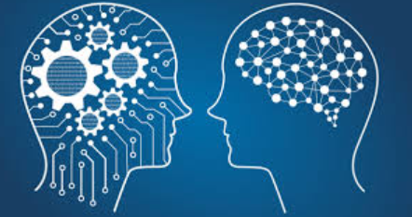
Artificial Intelligence

Slide 10
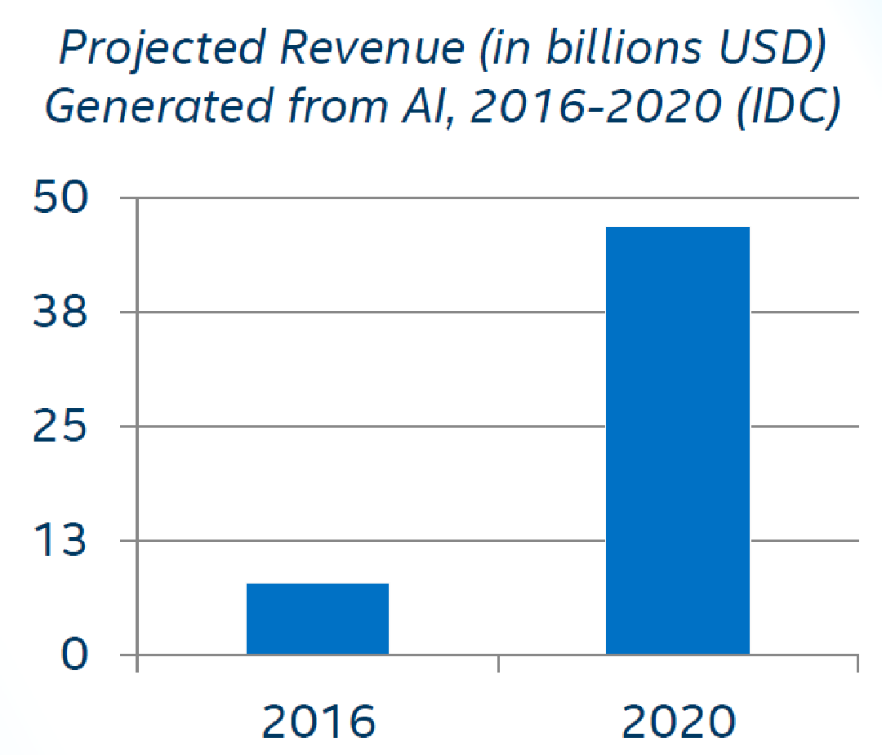
AI is The New Electricity
“About 100 years ago, electricity transformed every major industry. AI has advanced to the point where it has the power to transform…every major sector in coming years.”
-Andrew Ng, Stanford University

Slide 11
Definitions
Artificial Intelligence
A program that can sense, reason, act and adopt
▪Artificial Intelligence
▪Machine Learning
▪Deep Learning
Machine Learning
Algorithms whose performance increases over the time
Deep Learning
Subset of Ml in which multi layered neural networks learn from vast amount of data
Notes:
AI- to handle unforeseem circumstances. BOSTON DYNAMICS VIDEO
Unstructured data, ML- structured.
AI is often used interchangeably with ML is because it’s not always straightforward to know whether the underlying data is structured or unstructured.

Slide 12


Artificial intelligence
1950 - “Turing Test” by Alan Turing
1956’s - “Artificial intelligence” by John McCarthy

Slide 13
Artificial Intelligence
“A branch of computer science dealing with the simulation of intelligent behavior in computers.” (Merriam-Webster)
“A program that can sense, reason, act, and adapt.” (Intel)
“Colloquially, the term ‘artificial intelligence’ is applied when a machine mimics ‘cognitive’ functions that humans associate with other human minds, such as ‘learning' and ‘problem solving’.” (Wikipedia)

Slide 14
Machine Learning
“The process by which a computer is able to improve its own performance (as in analyzing image files) by continuously incorporating new data into an existing statistical model” - Merriam - Webster’s dictionary
“Building algorithms that allow computers to develop new behaviors based on experience” — Adam Piore
Notes:
ml:
-data: get a lot of cleaned data. is this email a spam? age, height etc.
- training: use data to tune relative significant features
- inference: predict something new

Slide 15
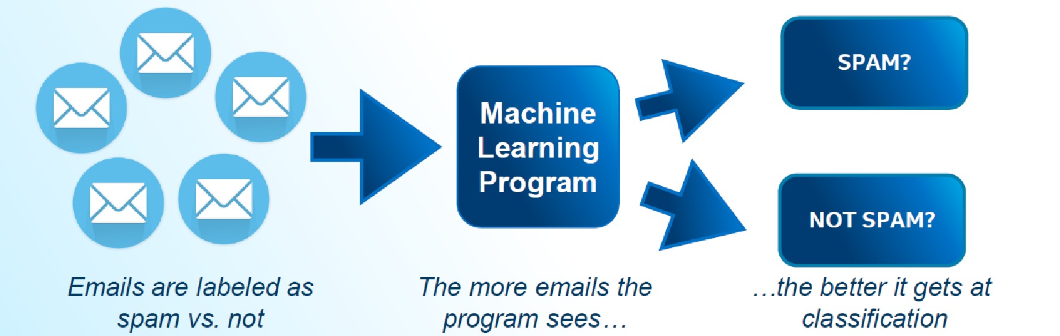
Machine Learning
These programs learn from repeatedly seeing data, rather than being explicitly programmed by humans.

Slide 16

Machine Learning Example
Suppose you wanted to identify fraudulent credit card transactions.
You could define features to be:
Transaction time
Transaction amount
Transaction location
Category of purchase
The algorithm could learn what feature combinations suggest unusual activity.

Slide 17
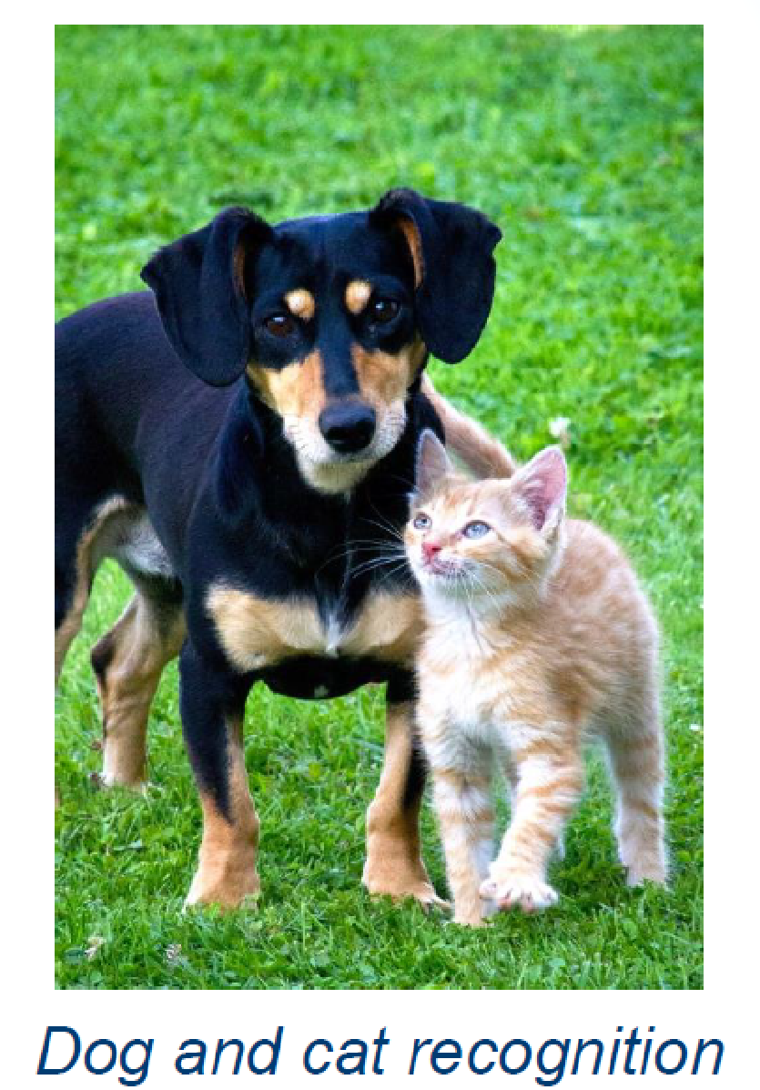
Machine Learning Limitations
Suppose you wanted to determine if an image is of a cat or a dog.
What features would you use?
This is where Deep Learning can come in.

Slide 18
Deep Learning
Deep learning is the sub-field of machine learning focused on developing algorithms consisting of multilayer artificial neural networks inspired by human brain structure called neurons.
“Machine learning that involves using very complicated models called “deep neural networks”." (Intel)
Models determine best representation of original data; in classic machine learning, humans must do this.

Slide 19

Machine Learning Classification

Slide 20
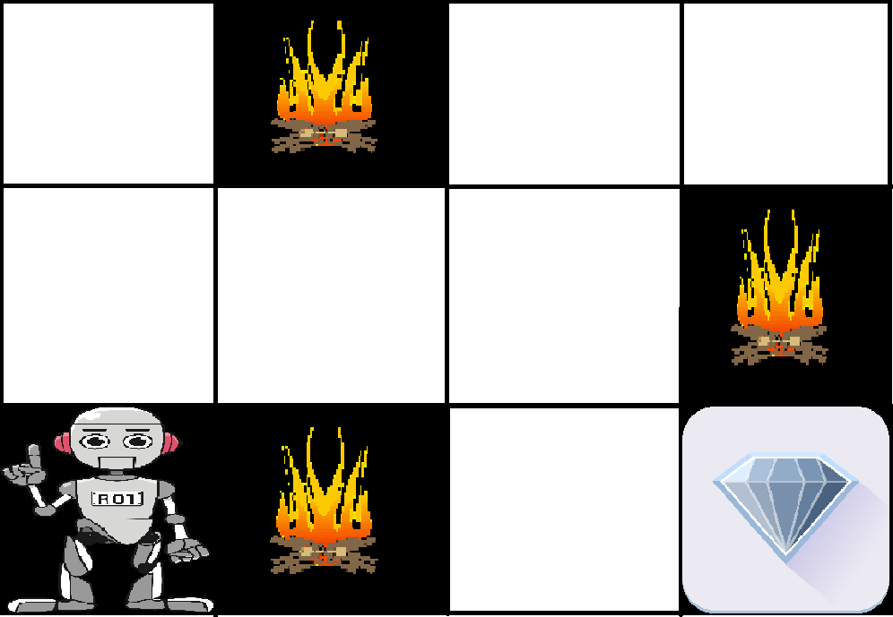
Reinforcement learning

Slide 21
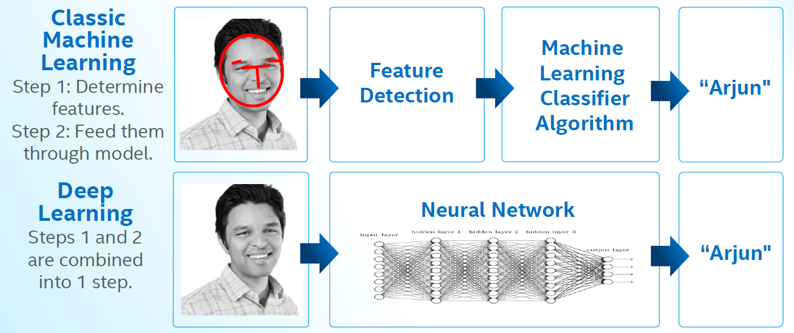
Deep Learning Example

Slide 22
History
AI

Slide 23
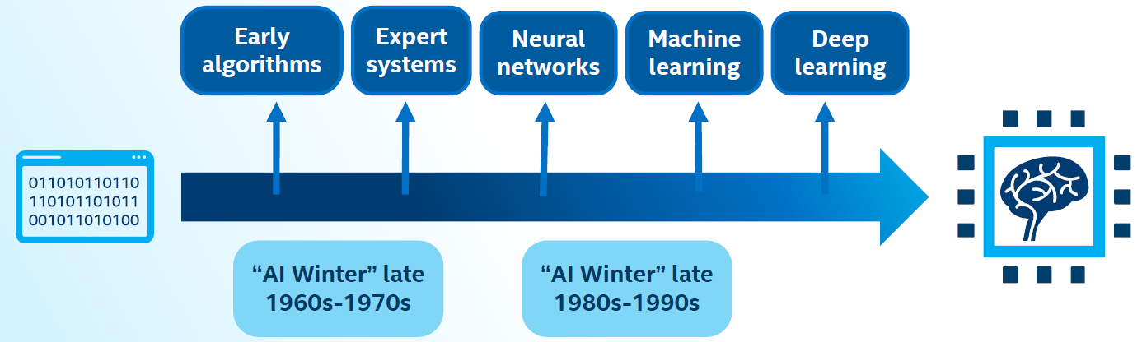
History of AI
AI has experienced several hype cycles, where it has oscillated between periods of excitement and disappointment.

Slide 24
1950s: Early AI
Alan Turing developed the Turing test to test a machines ability to exhibit intelligent behavior.
Frank Rosenblatt invented the perceptron algorithm. This was the precursor to modern neural networks.
1956
1959
1950
1957
Artificial Intelligence was accepted as a field at the Dartmouth Conference.
Arthur Samuel published an algorithm for a checkers program using machine learning.

Slide 25




The First “AI Winter”
1966: ALPAC committee evaluated AI techniques for machine translation and determined there was little yield from the investment.
1969: Marvin Minsky published a book on the limitations of the Perceptron algorithm which slowed research in neural networks.
1973: The Light hill report highlights AI’s failure to live up to promises.
The two reports led to cuts in government funding for AI research leading to the first “AI Winter.”
Notes:
ALPAC (Automatic Language Processing Advisory Committee) was a committee of seven scientists led by John R. Pierce, established in 1964 by the United States government in order to evaluate the progress in computational linguistics in general and machine translation in particular.

Slide 26

1980’s AI Boom
Expert Systems -systems with programmed rules designed to mimic human experts.
Ran on mainframe computers with specialized programming languages (e.g. LISP).
Were the first widely-used AI technology, with two-thirds of "Fortune 500"companies using them at their peak.
1986: The “Backpropogation” algorithm is able to train multi-layer perceptrons leading to new successes and interest in neural network research.

Slide 27


Late 1990’s to present
Late 1990’s to early 2000’s: Classical Machine Learning
2006: Rise of Deep Learning
AI solutions had successes in speech recognition, medical diagnosis, robotics, and many other areas.
Google search engine launched using artificial intelligence technology.
2006: Geoffrey Hinton publishes a paper on unsupervised pre-training that allowed deeper neural networks to be trained.
2010: Algorithms compete on several visual recognition tasksat the first ImageNet competition.

Slide 28
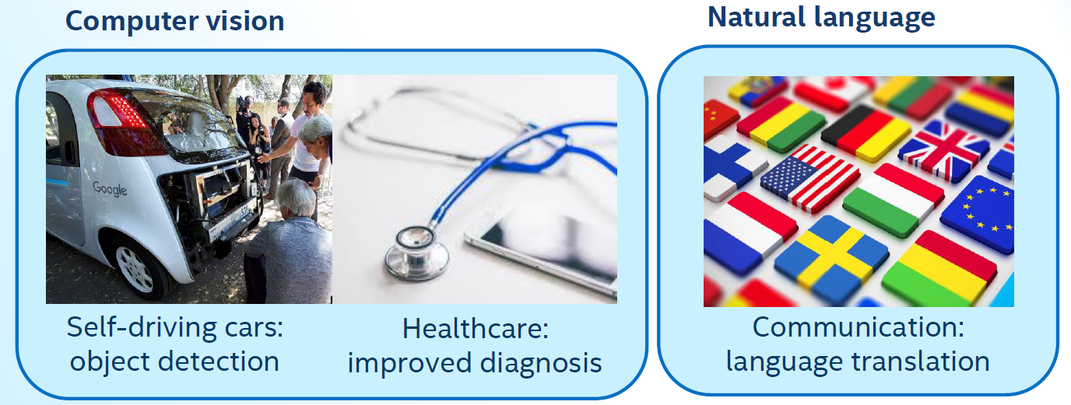
Modern AI (2012 –Present): Deep Learning Impact

Slide 29
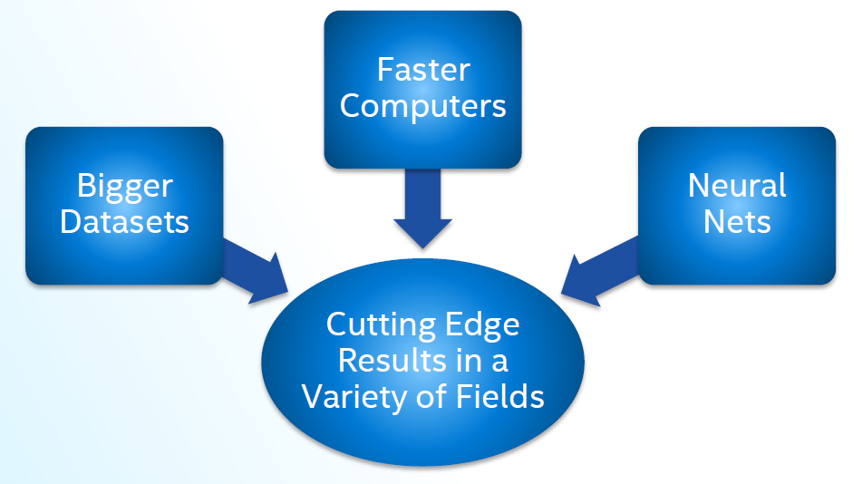
How Is This Era of AI Different?

Slide 30




Modern AI Factors
Continued expansion of open source AI, especially in Python*, aiding machine learning and big data ecosystems.
Leading deep learning libraries open sourced, allowing further adoption by industry.
Open sourcing of large datasets of millions of labeled images, text datasets such as Wikipedia has also driven breakthroughs.
High Performance Computing

Slide 31
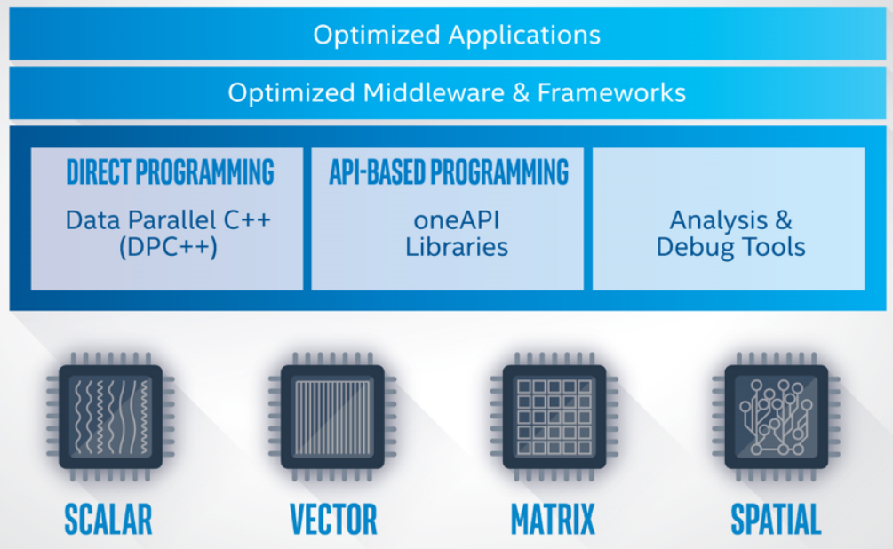
Intel OneAPI - Cross Architecture Performance
oneAPI is a cross-industry, open, standards-based unified programming model that delivers a common developer experience across accelerator architectures—for faster application performance, more productivity, and greater innovation.
The oneAPI industry initiative encourages collaboration on the oneAPI specification and compatible oneAPI implementations across the ecosystem.
Short Video Link
https://software.intel.com/content/www/us/en/develop/tools/oneapi.html#gs.36k4jr
Notes:
Intel Parallel Studio XE is a software development product developed by Intel that facilitates native code development on Windows, macOS and Linuxin C++ and Fortran for parallel computing.^{[2]} Parallel programming enables software programs to take advantage of multi-core processors from Intel and other processor vendors.
Intel Vtune amplifier- Stop guessing why software is slow. Advanced sampling and profiling techniques quickly analyze your code, isolate issues, and deliver insights for optimizing performance on modern processors.
Intel inspector- Locate and debug threading, memory, and persistent memory errors in applications early in the design cycle to avoid costly errors later.
Intel Advisor- Design and optimize high-performing code for modern computer architectures. Effectively use more cores, vectorization, and heterogeneous processing.

Slide 32
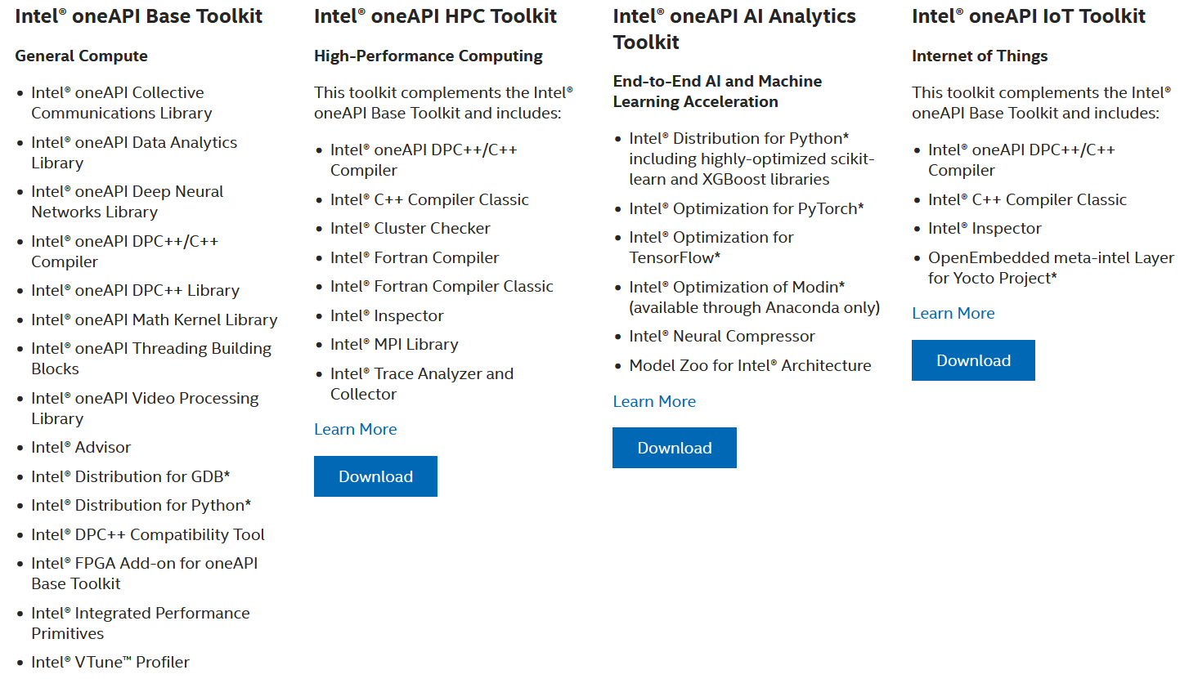
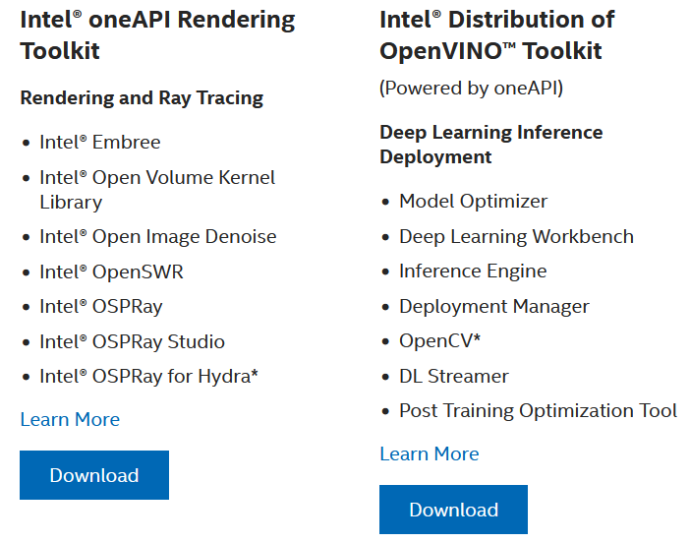
Intel OneAPI Toolkits
These toolkits are for performance-driven applications—HPC, IoT, advanced rendering, deep learning frameworks, and more—that are written in DPC++, C++, C, and Fortran languages.
Notes:
Intel Parallel Studio XE is a software development product developed by Intel that facilitates native code development on Windows, macOS and Linuxin C++ and Fortran for parallel computing.^{[2]} Parallel programming enables software programs to take advantage of multi-core processors from Intel and other processor vendors.
Intel Vtune amplifier- Stop guessing why software is slow. Advanced sampling and profiling techniques quickly analyze your code, isolate issues, and deliver insights for optimizing performance on modern processors.
Intel inspector- Locate and debug threading, memory, and persistent memory errors in applications early in the design cycle to avoid costly errors later.
Intel Advisor- Design and optimize high-performing code for modern computer architectures. Effectively use more cores, vectorization, and heterogeneous processing.

Slide 33
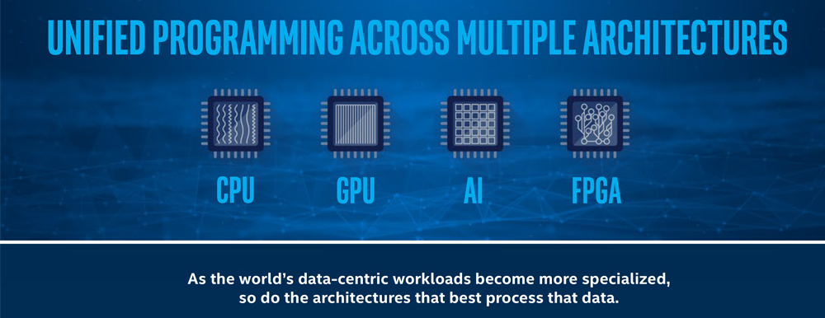
What is oneAPI?

Slide 34
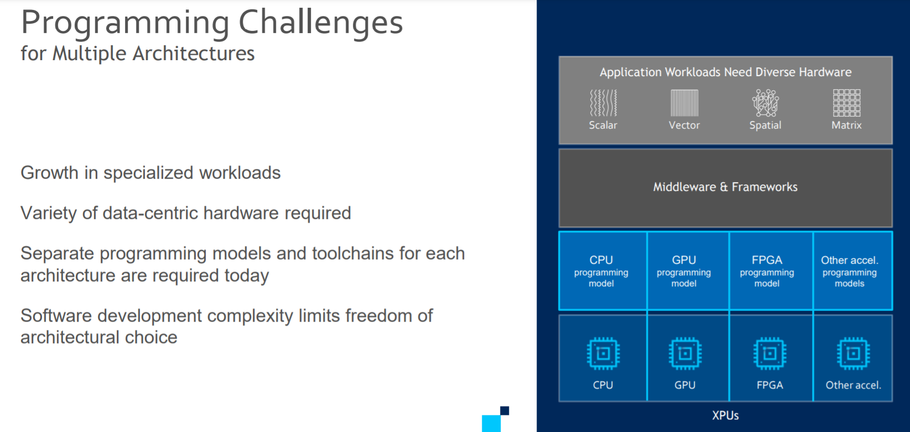

Slide 35
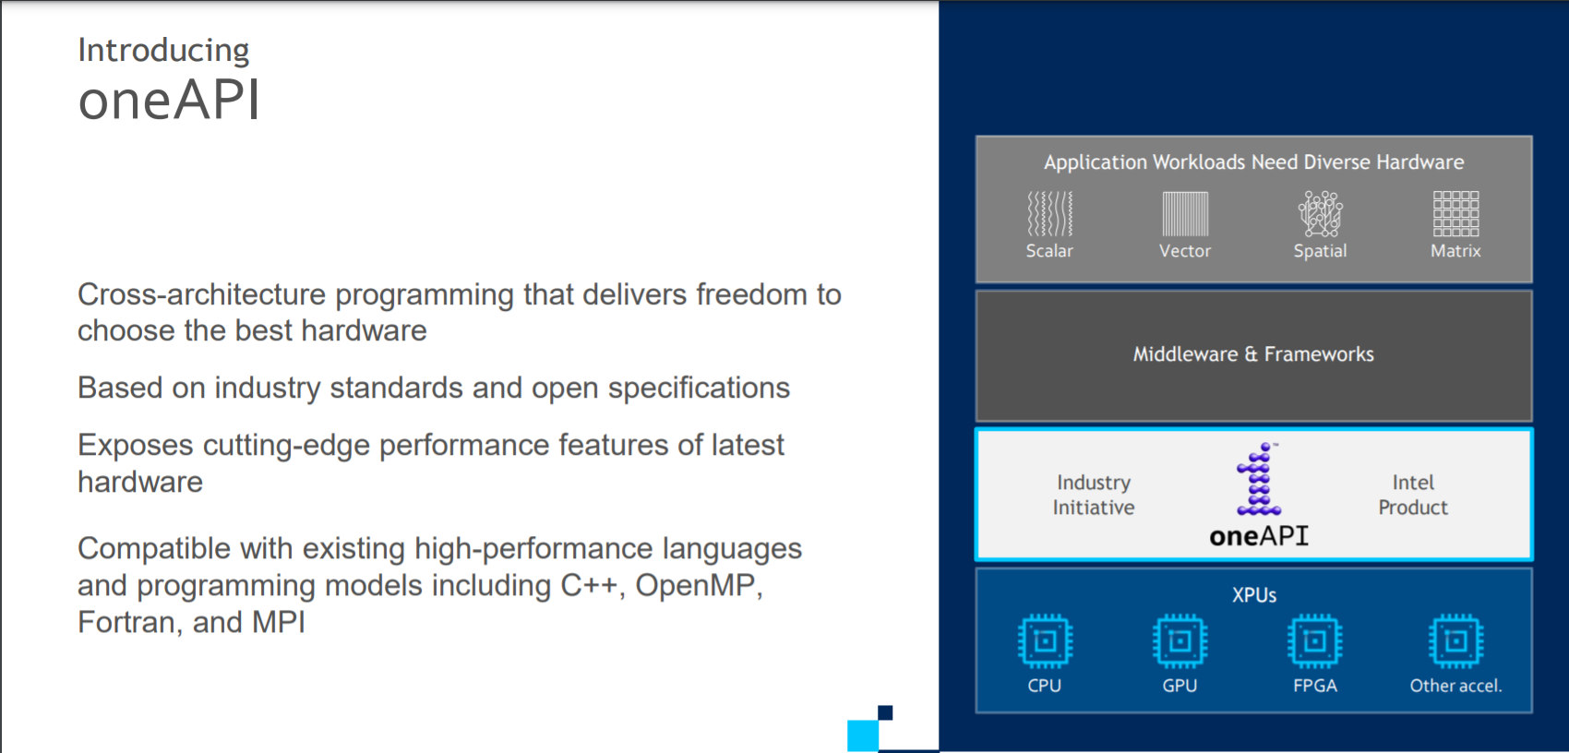

Slide 36
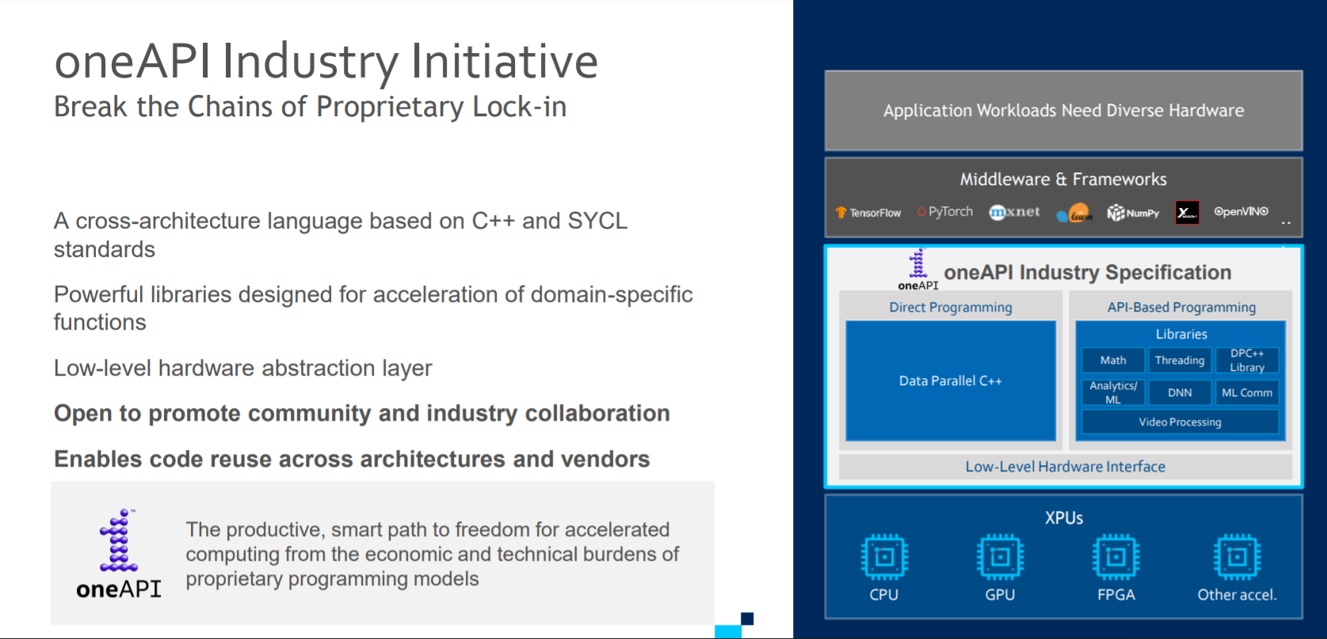

Slide 37
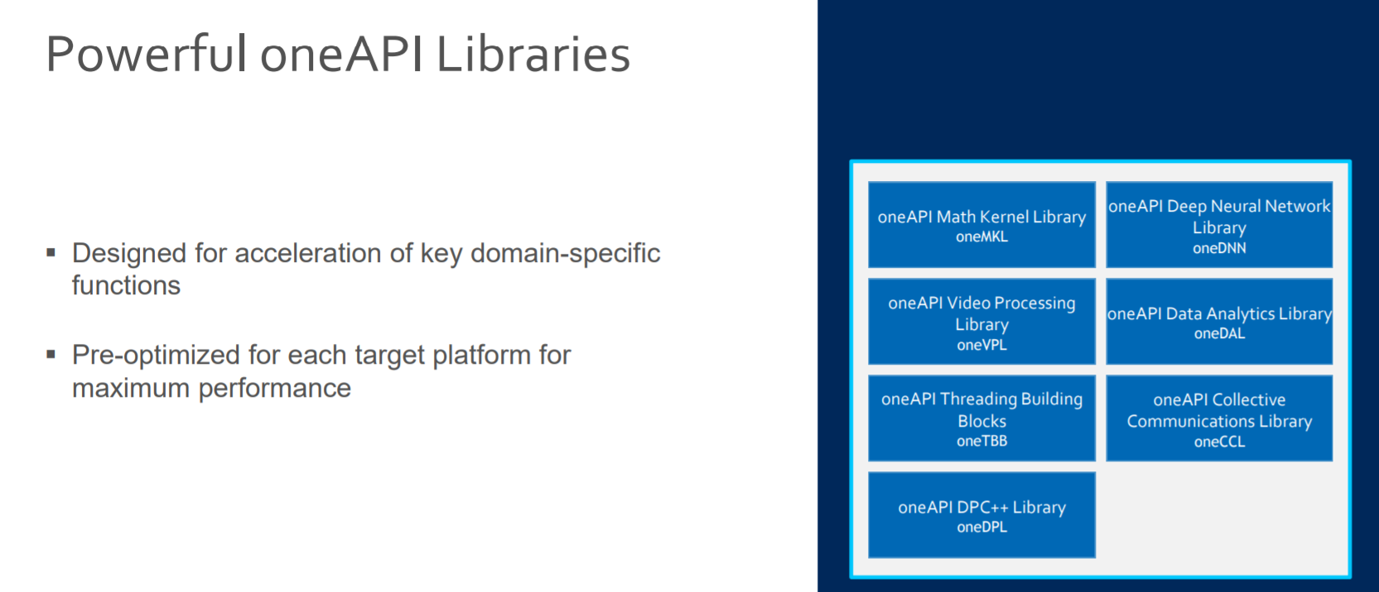

Slide 38
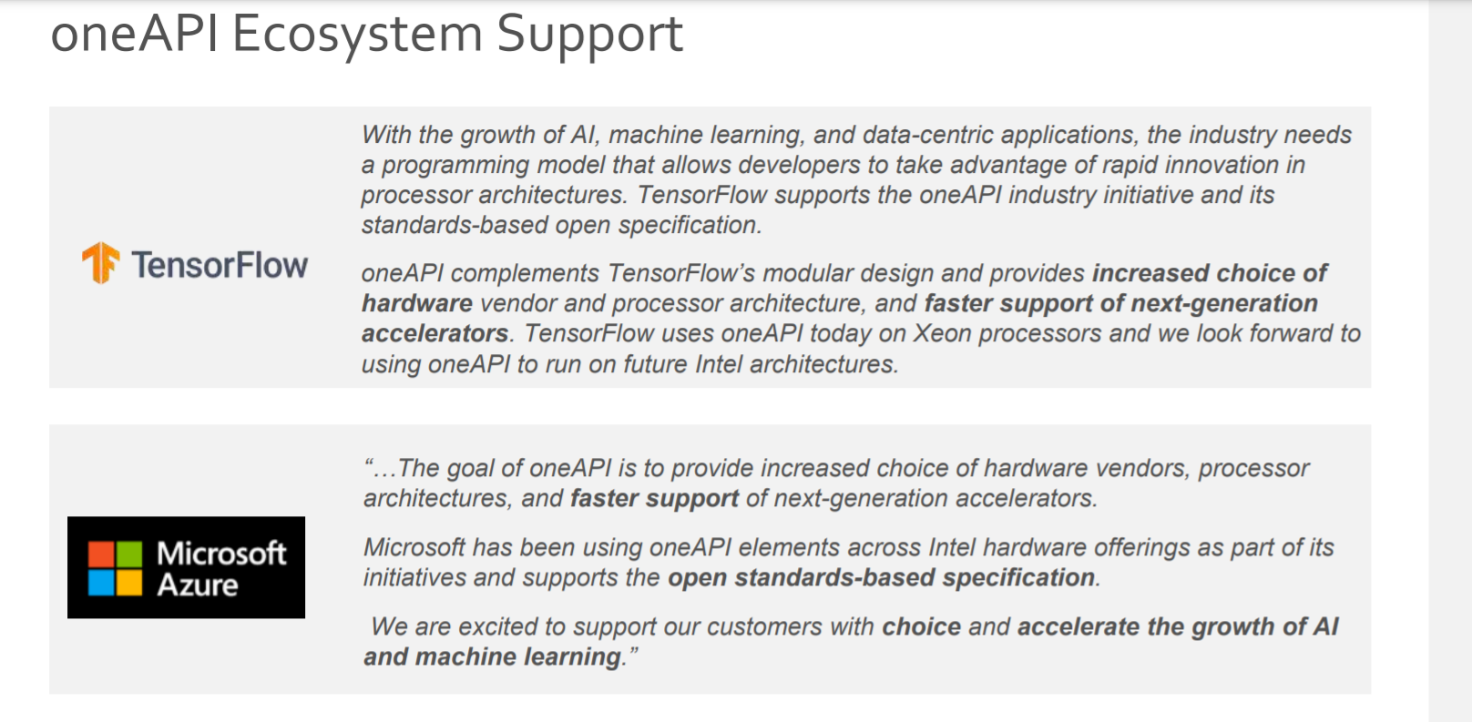

Slide 39
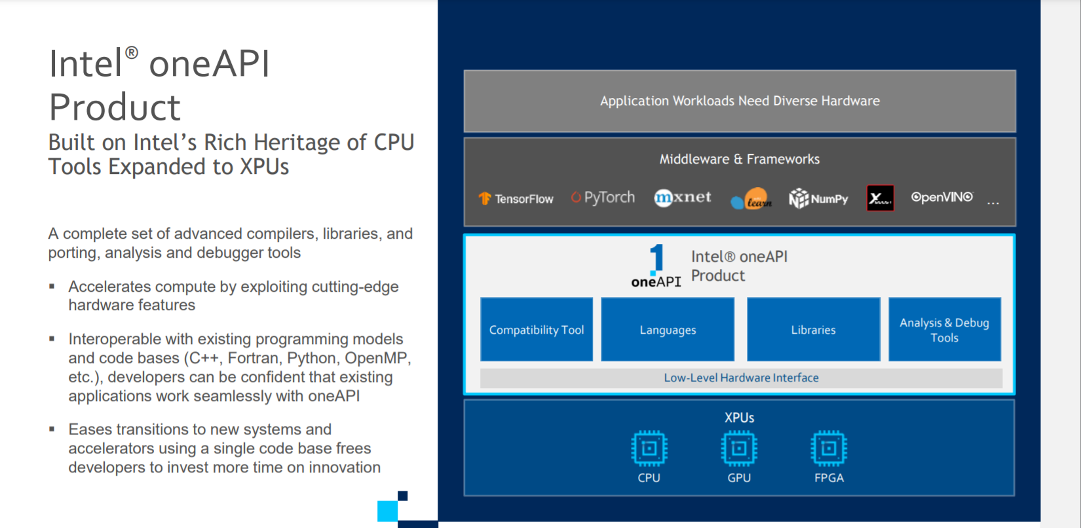

Slide 40
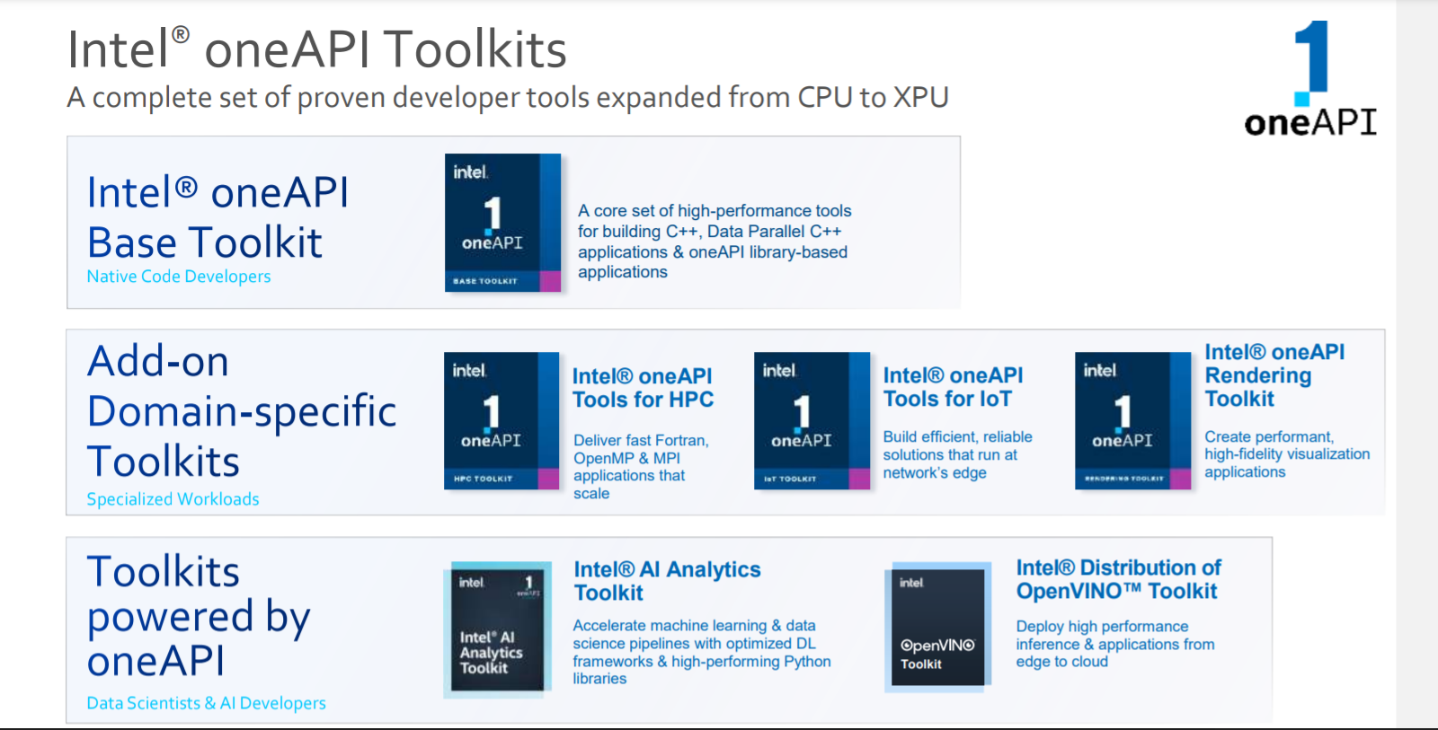

Slide 41
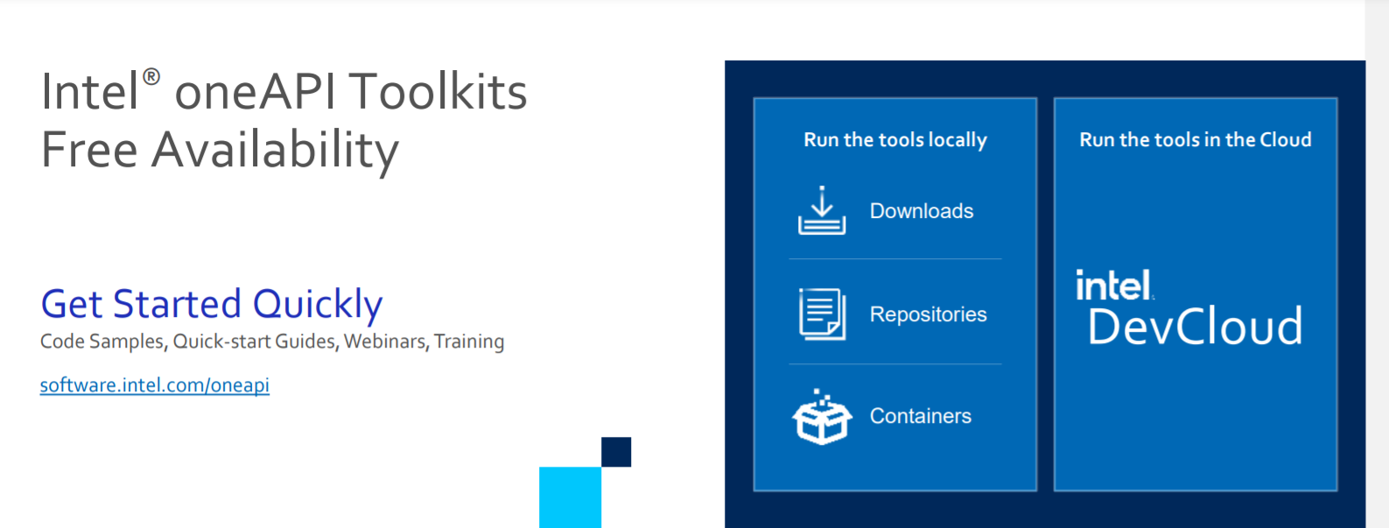
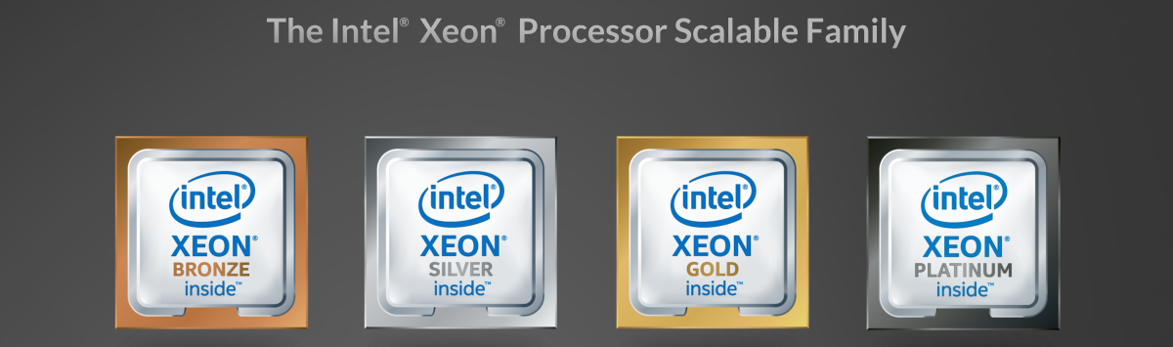
What is Intel Dev Cloud ?

Slide 42
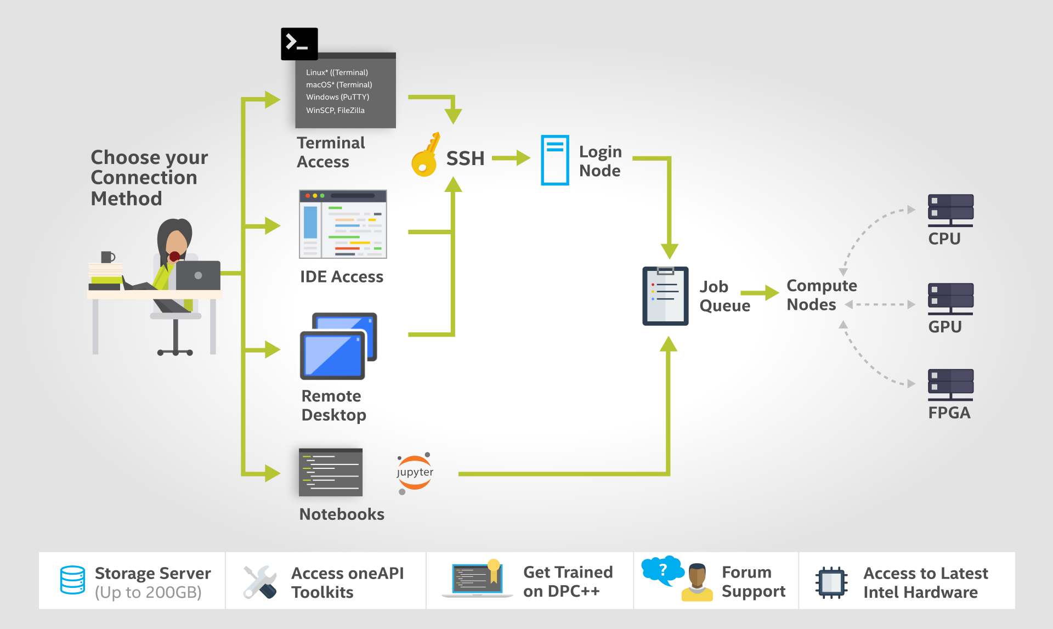
How DevCloud works?

Slide 43
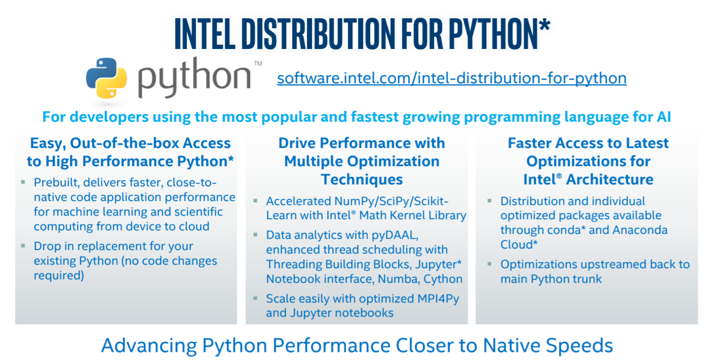

Slide 44
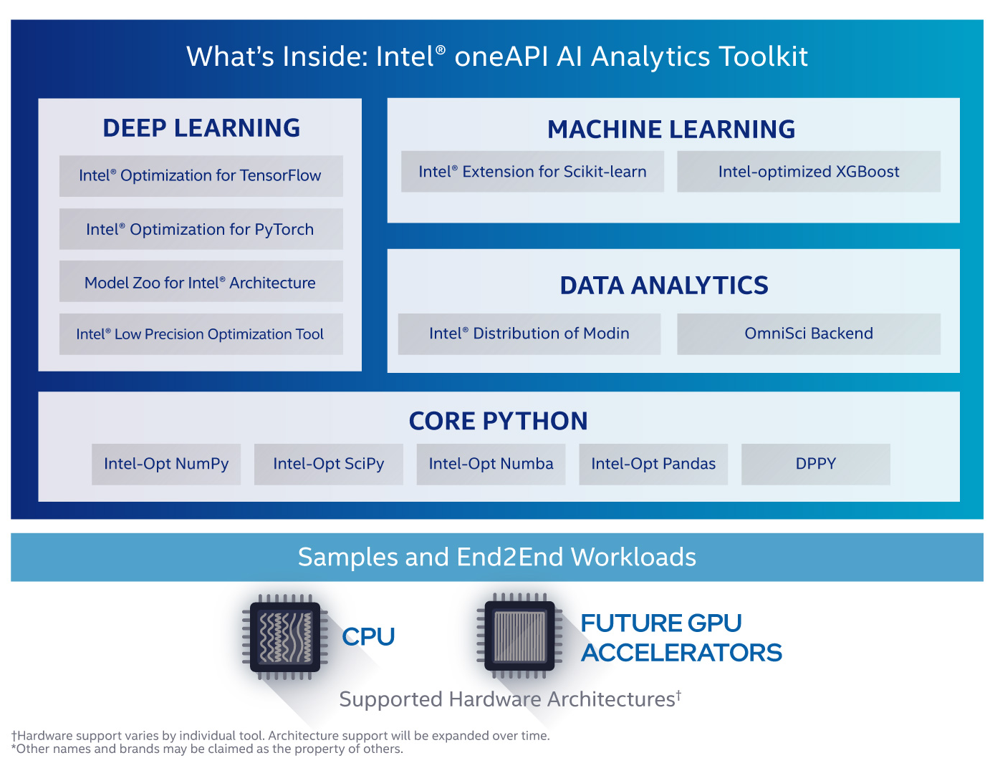

Slide 45
What software are required for this workshop?
Anaconda Software on Ubuntu
Intel Distribution of Python
Intel DevCloud for OneAPI

Slide 46
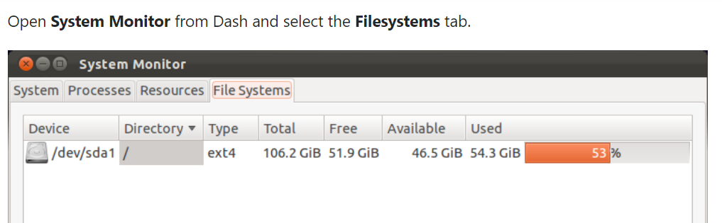
Important Ubuntu Commands
Check Ubuntu version
lsb_release –a
cat /etc/issue.net
Check Disk Space
df -h

Slide 47

Steps for downloading Intel Distribution of Python
Download Anaconda/Miniconda software
https://docs.anaconda.com/anaconda/install/linux/
Check Conda version
conda --version
Update Anaconda package
conda update conda

Slide 48
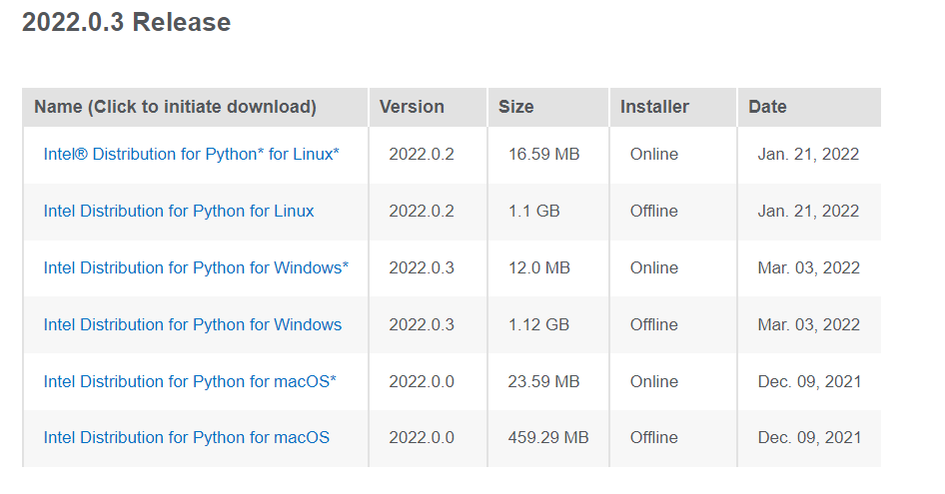
Intel Distribution of Python
https://www.intel.com/content/www/us/en/developer/articles/tool/oneapi-standalone-components.html#python

Slide 49
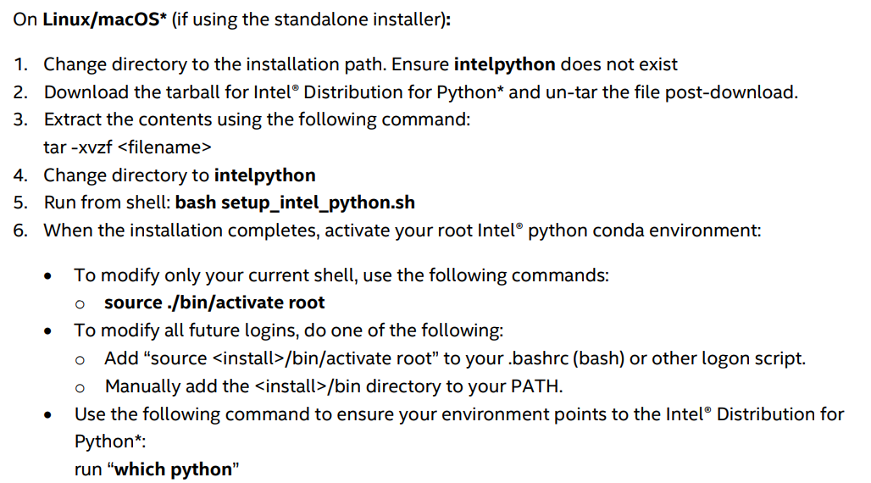
Intel Distribution of Python
https://www.intel.com/content/dam/develop/external/us/en/documents/2022_Python_Release_Notes_Intel(R)_Distribution_for_Python-Release1.pdf

Slide 50
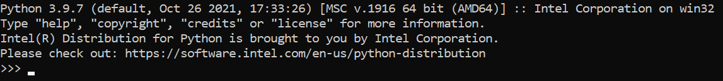
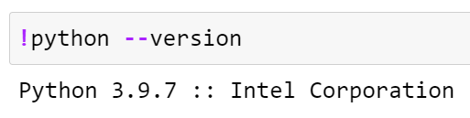
Checking if Python Intel is installed or not
On Anaconda Prompt, type python
In Jupyter Notebook, check the above statement in the code cell
Notes:
https://www.intel.com/content/www/us/en/developer/articles/tool/oneapi-standalone-components.html#python

Slide 51
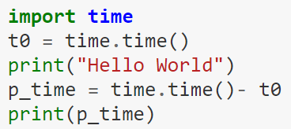
Time module in Python
%time
Use of time module from Python Standard library

Slide 52

Please contact
Foundation for Innovation and Collaborative
Education
mentor@fice.in
www.fice.in
Please contact
Foundation for Innovation and Collaborative
Education
info@fice.in
mentor@fice.in
Notes:
Here are the lessons we are going to learn today.

